Slide 1

Your Budget Buddy!
Who’s ready to start saving money

Slide 2

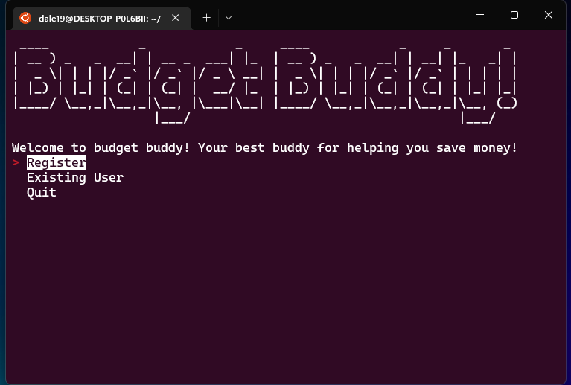
Walkthrough
The main menu provides the option for users to Register, Use an existing user or quit
If there are no existing users it will prompt you to Create a new one

Slide 3
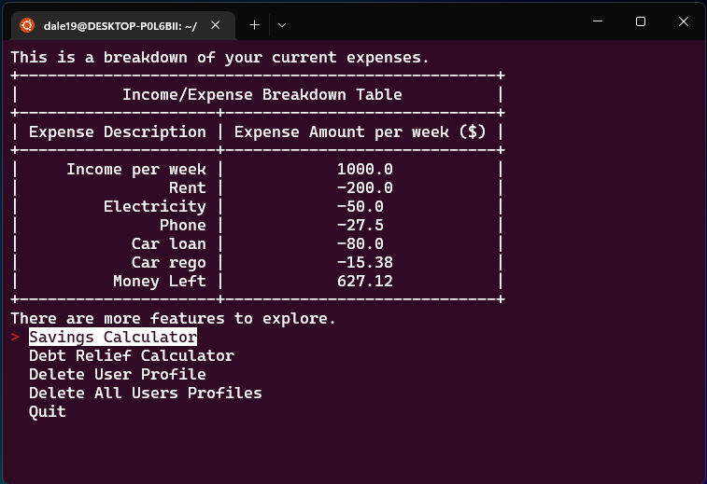
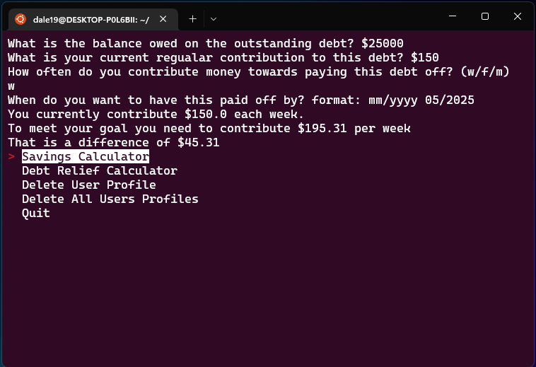
Budget Breakdown
After Creating a user or logging in to existing user, the application asks for inputs of income and any expenses.
After gathering this information it will ask if you would like to have it displayed in a table as shown
The menu after shows the next features that the user can access
Calculators Breakdown
The debt and savings calculators are similar as they take inputs from the user to calculate a final message to inform the user
In this example it shows how much more the user needs to contribute per week to reach there goal of paying this debt off by 05/2025

Slide 4
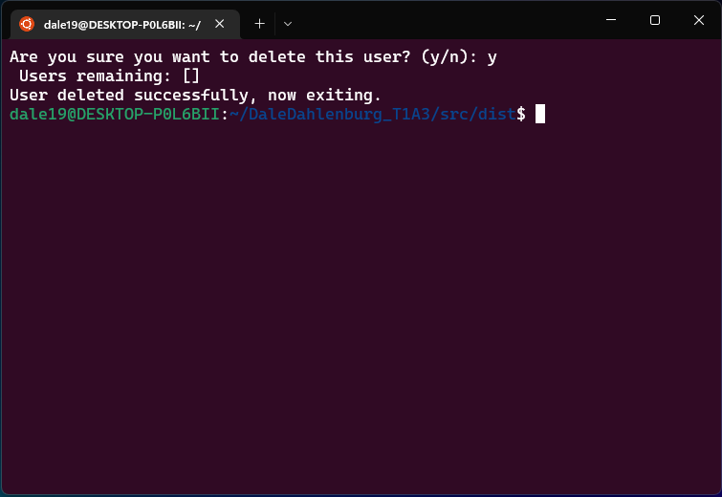
User Cleanup
Delete User
The user is also offered the chance to delete their saved profile
Also an option to delete all users, however do need a master password to accomplish this
Delete all option as the code creates new files for new users, offers way to clean up folders

Slide 5
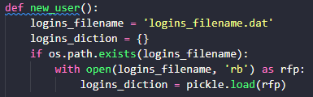
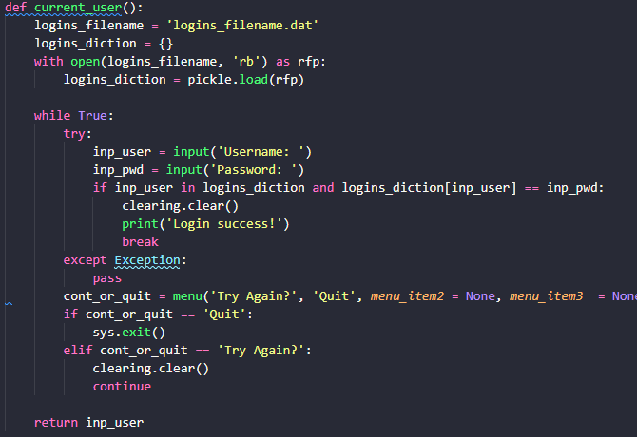
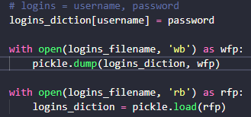
Login logic
This logic was crucial for repeat users
Runs through how pickle creates new users
Also shows how pickle opens existing files

Slide 6
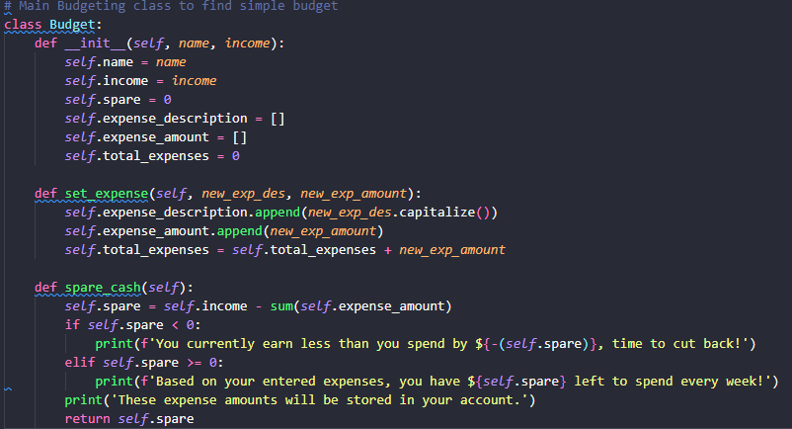
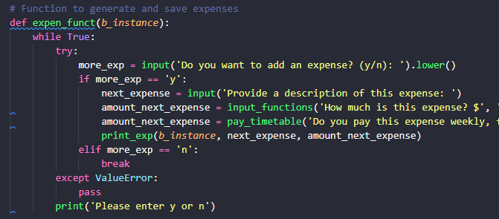
Budget Logic
Uses Budget Class to be able to pass in user input data to create lists of expenses
These lists are then appended with user input data that has been correctly formatted
Functions also incorporate other previously stated functions to create DRY code

Slide 7
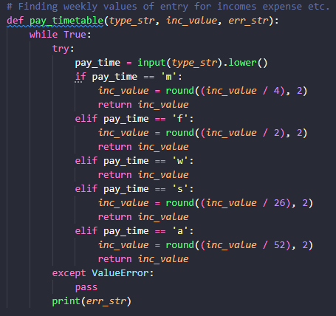
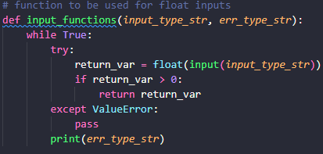
Error Handling
As the script accepts user input frequently, error handling for user input was developed using while-True loops
Each of the different input functions had the error handling directly in the function

